Slide 1
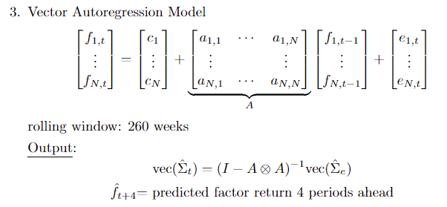
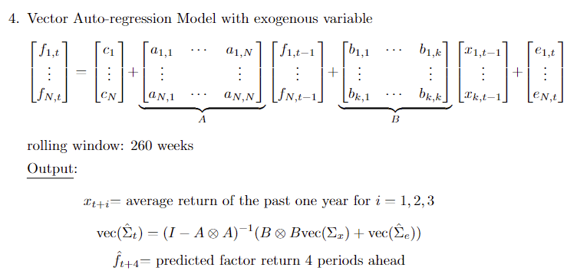
Model Changes

Slide 2
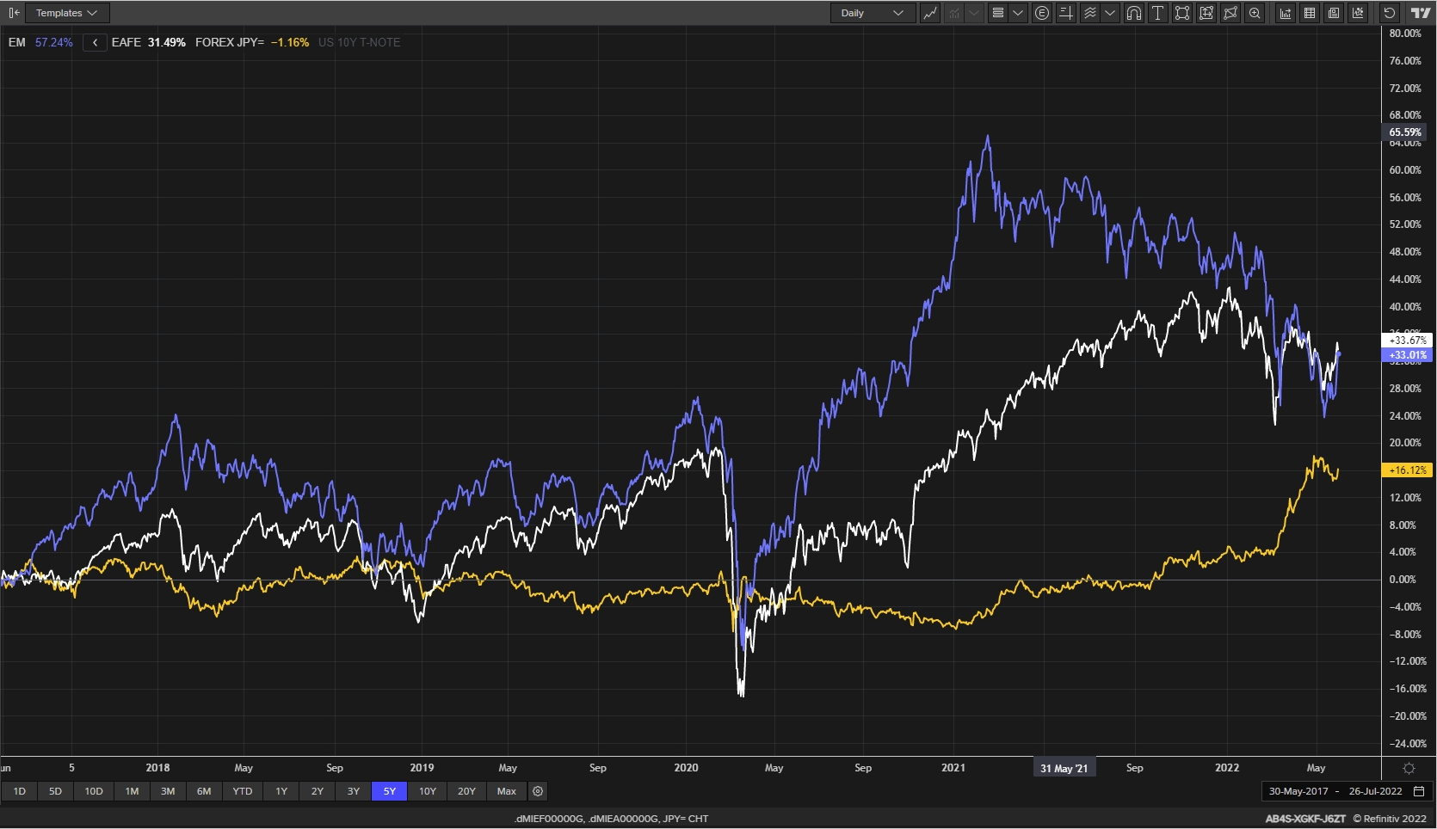
Exogeneous Variables
em: MSCI Emerging Markets Gross Index (Local Currency)
dm: MSCI EAFE Gross Index (Local Currency)
jpyusd: JPY/USD
tbill10y: US 10-Year Treasury Bill

Slide 3
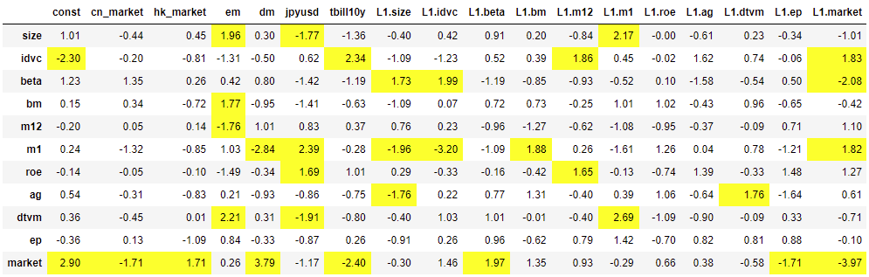
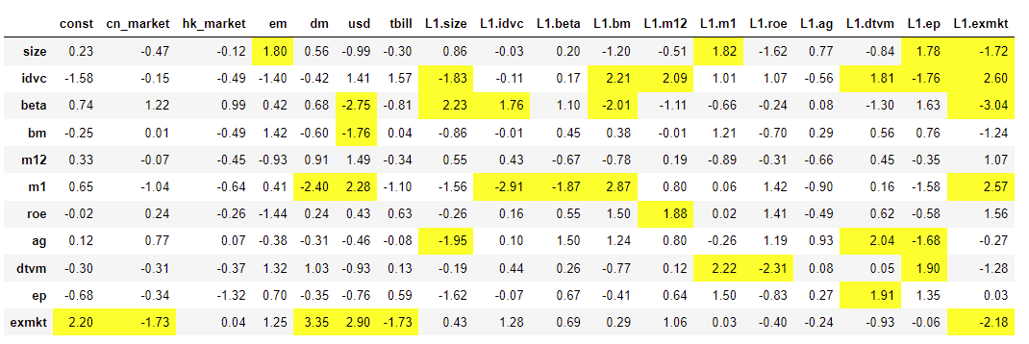
U.S. Significant Variables

Slide 4
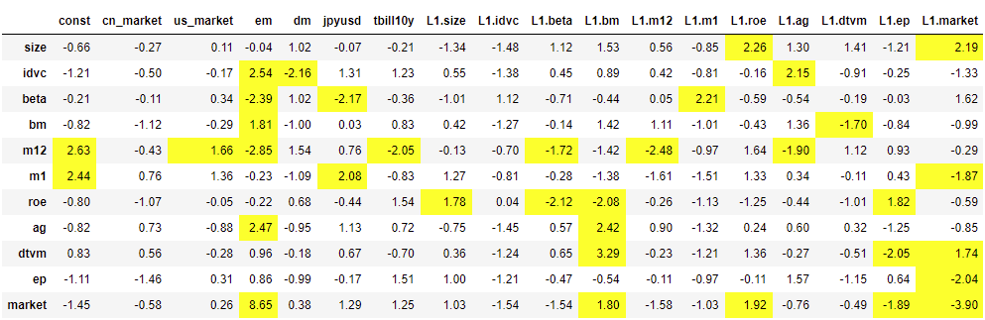
Hong Kong Significant Variables

Slide 5
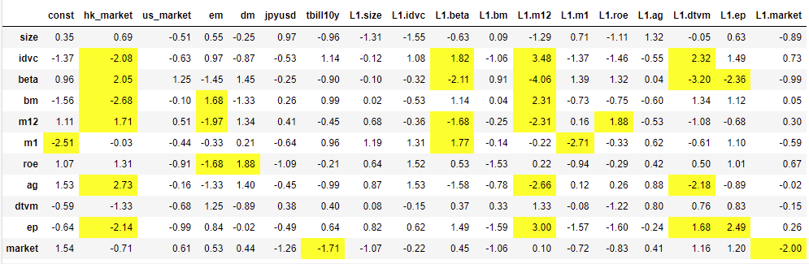
A-Share Significant Variables

Slide 6
Summary
Market | Appetite | Best Sharpe (1y) | Model | Best Sharpe (5y) | Model | Best Sharpe (5y) No All In | Model
US | Agg | 1.52 | FACTORX(3Y) | 0.93 | FACTOR(3Y) | 0.89 | CAPM(3Y)
CN | Agg | 0.63 | FACTORX(3Y) | 0.57 | FACTORX | 0.26 | CAPM
HK | Agg | -0.45 | FACTORX | 0.78 | FACTORX | 0.78 | FACTORX
US | Med | 1.04 | FACTORX | 0.79 | CAPM | 0.79 | CAPM
CN | Med | 1.19 | FACTOR | 0.56 | FACTORX | 0.56 | FACTORX
HK | Med | -0.55 | CAPM, CAPM(3Y) | 0.69 | FACTORX | 0.69 | FACTORX
US | Con | 1.31 | FACTORX | 0.69 | FACTORX | 0.69 | FACTORX
CN | Con | 1.06 | FACTOR | 0.64 | CAPM | 0.64 | CAPM
HK | Con | -0.42 | FACTOR(3Y) | 0.61 | FACTORX | 0.61 | FACTORX

Slide 7
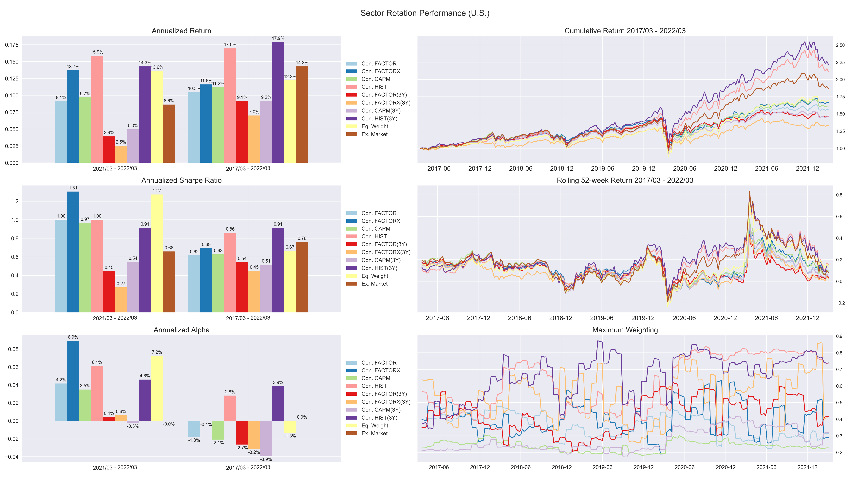
U.S. Portfolio – Conservative (5-year v.s. 3-year)

Slide 8
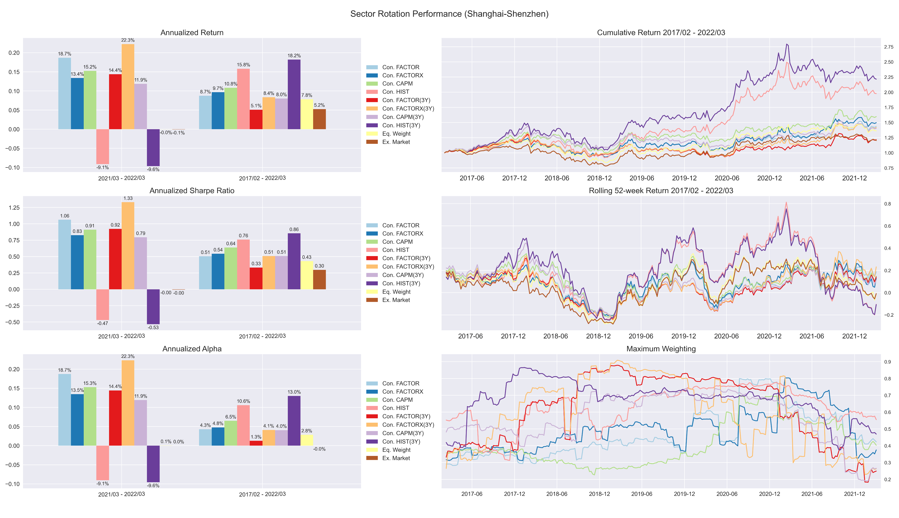
Shanghai-Shenzhen Portfolio – Conservative (5-year v.s. 3-year)

Slide 9
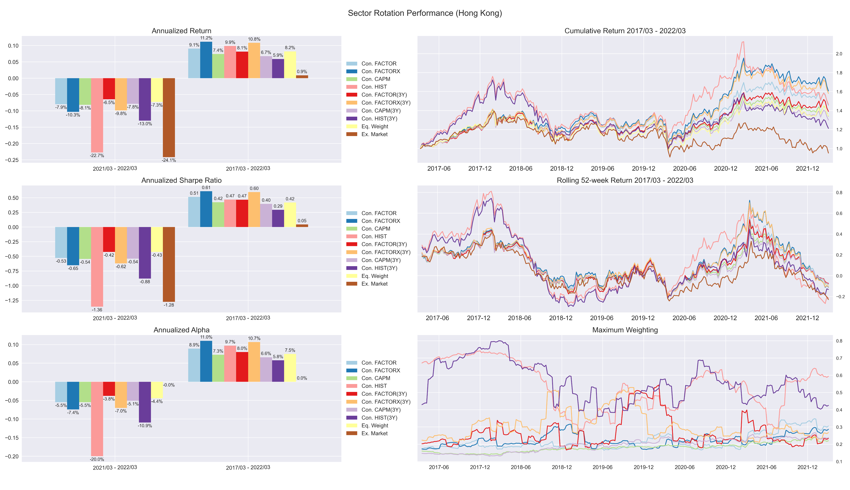
Hong Kong Portfolio – Conservative (5-year v.s. 3-year)

Slide 10
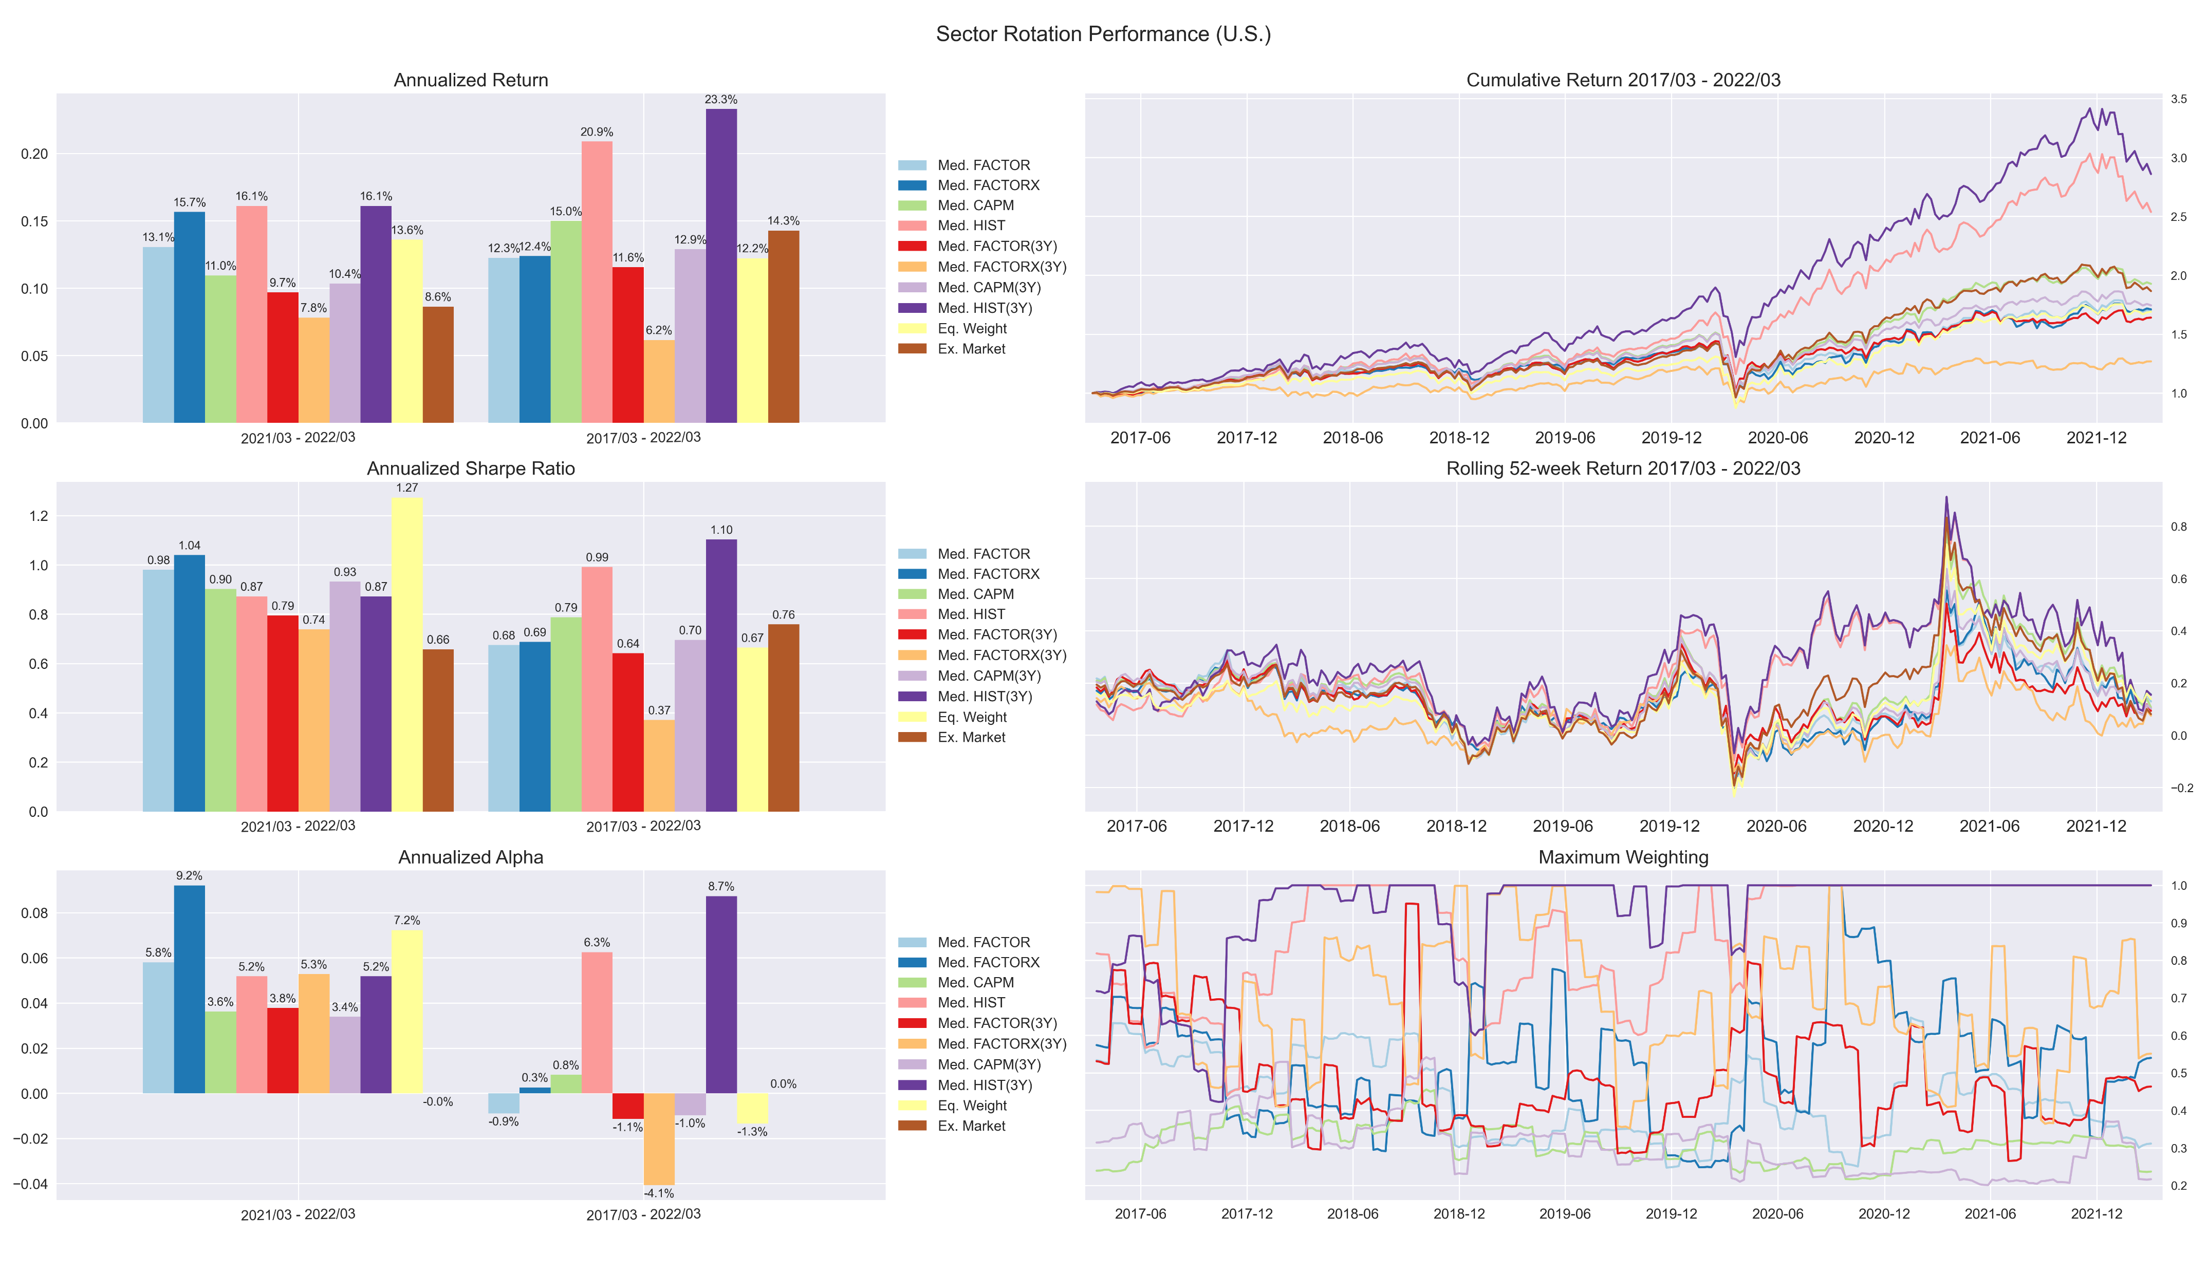
U.S. Portfolio – Medium (5-year v.s. 3-year)

Slide 11
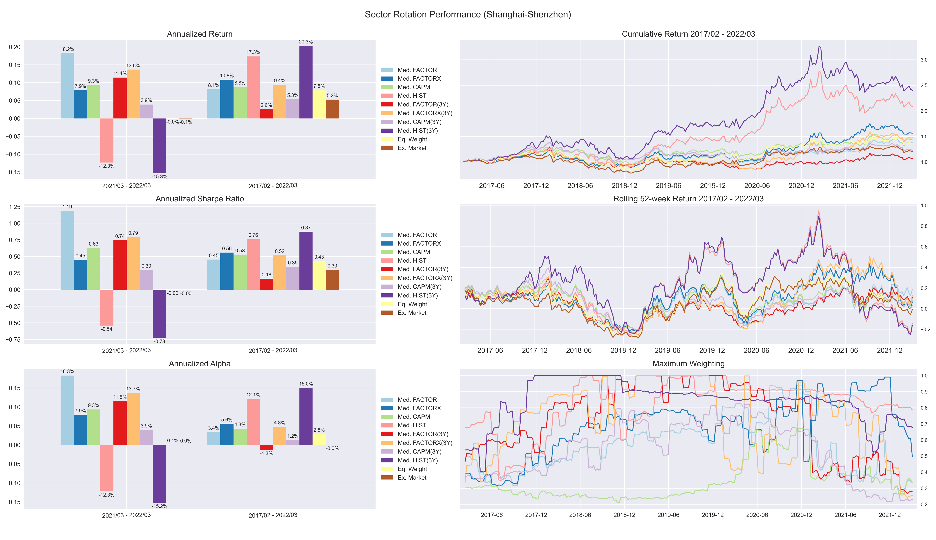
Shanghai-Shenzhen Portfolio – Medium (5-year v.s. 3-year)

Slide 12
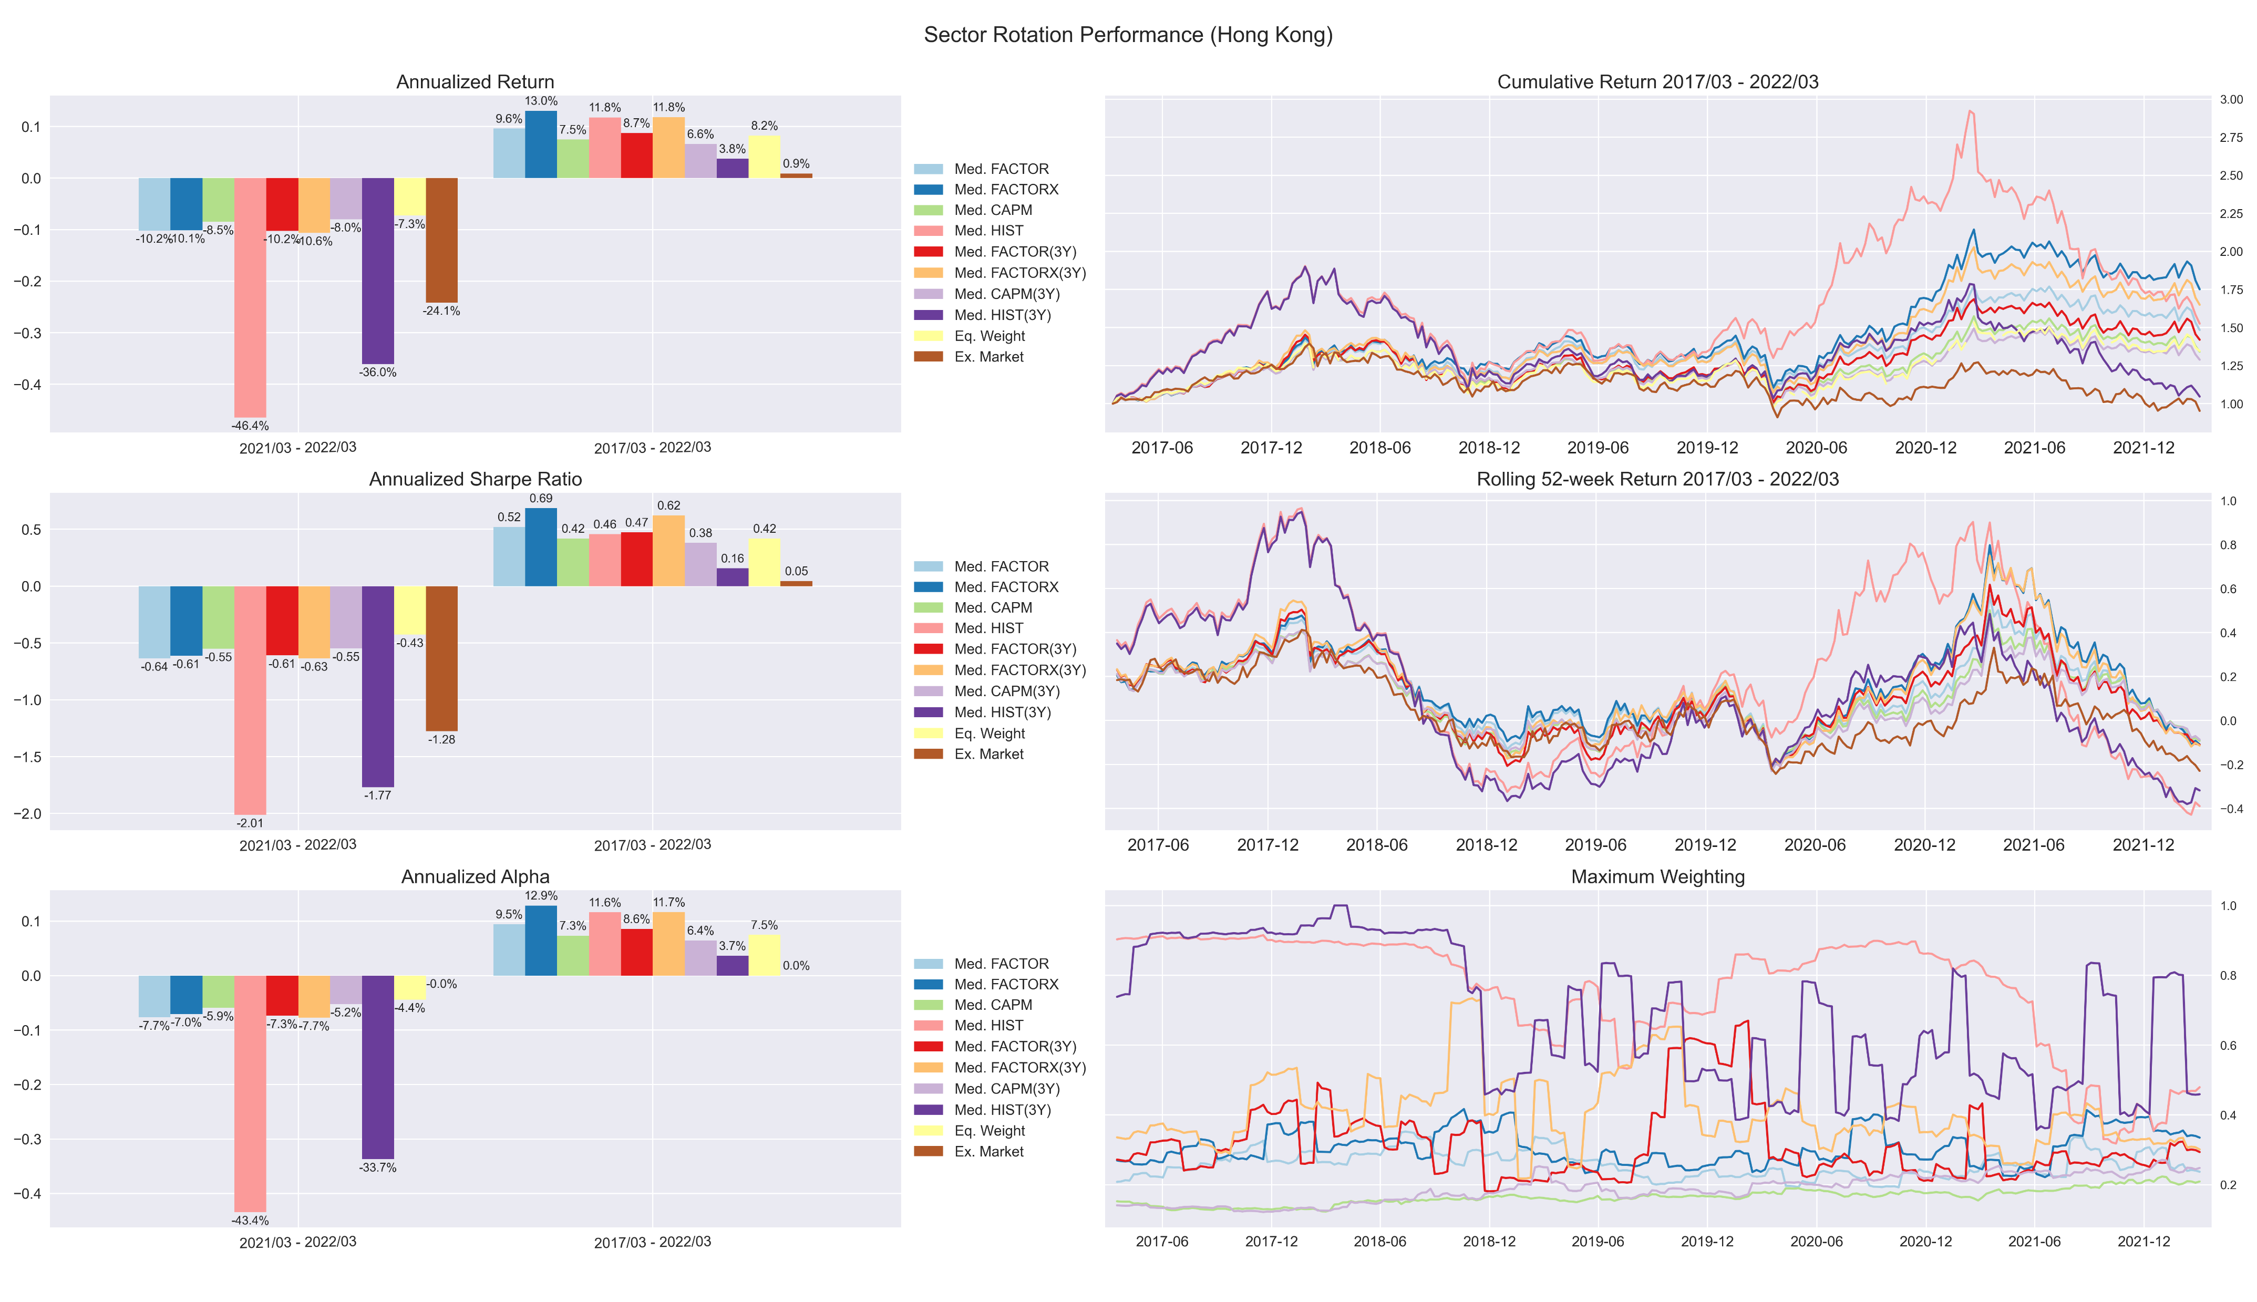
Hong Kong Portfolio – Medium (5-year v.s. 3-year)

Slide 13
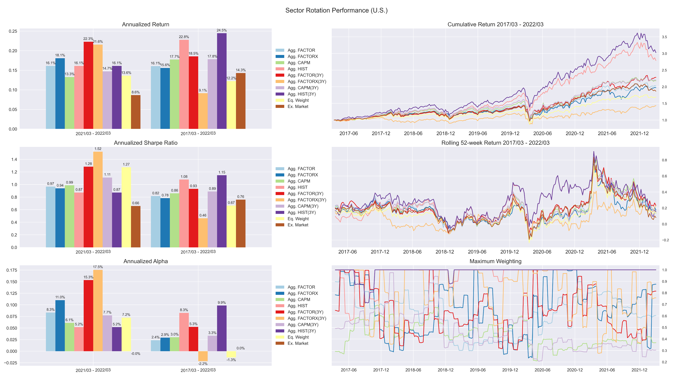
U.S. Portfolio – Aggressive (5-year v.s. 3-year)

Slide 14
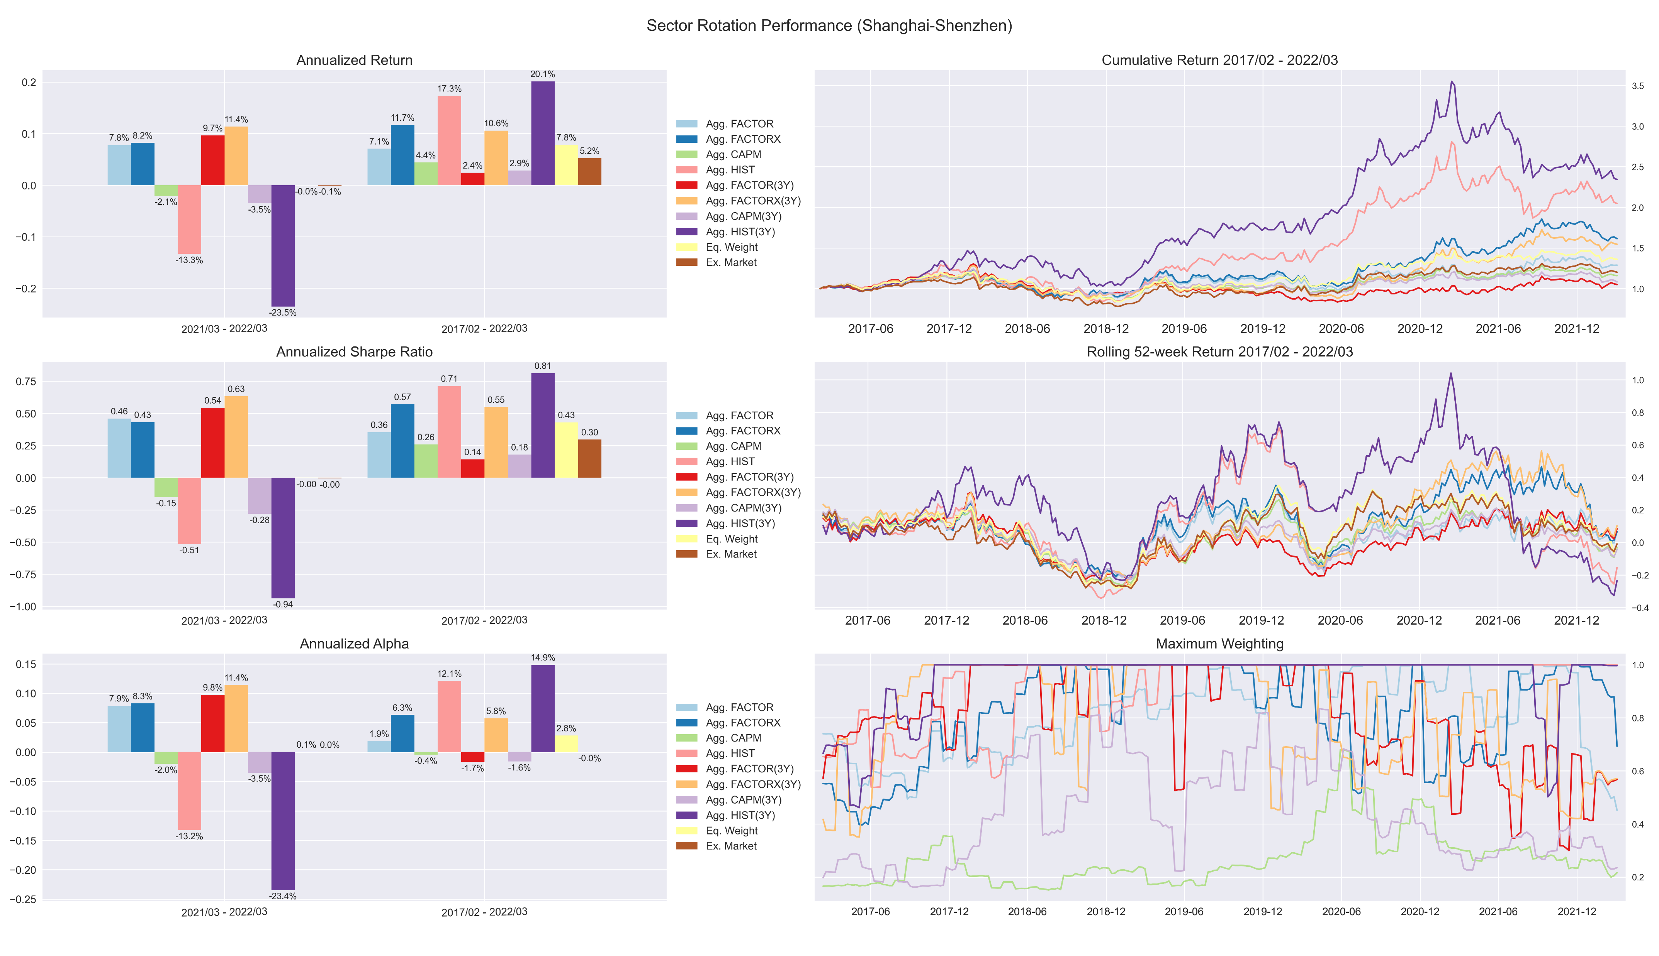
Shanghai-Shenzhen Portfolio – Aggressive (5-year v.s. 3-year)

Slide 15
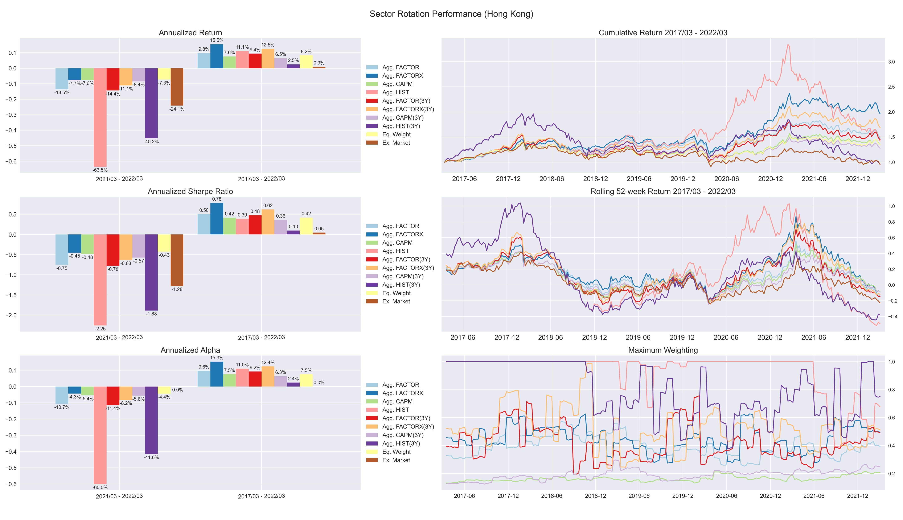
Hong Kong Portfolio – Aggressive (5-year v.s. 3-year)

Slide 16
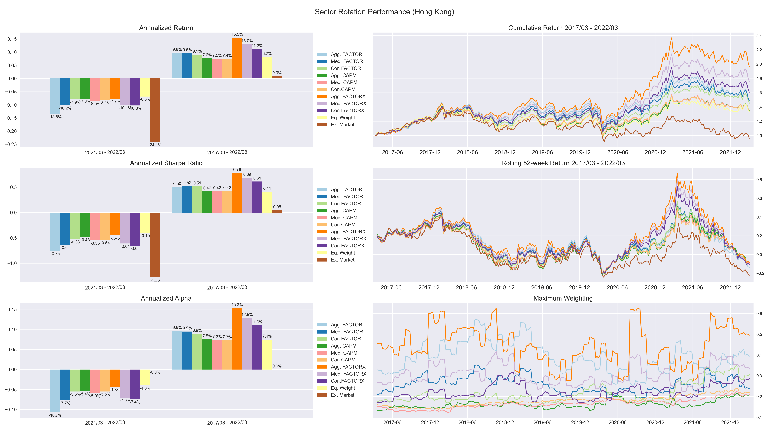
Hong Kong Portfolio – All (5-year window)

Slide 17
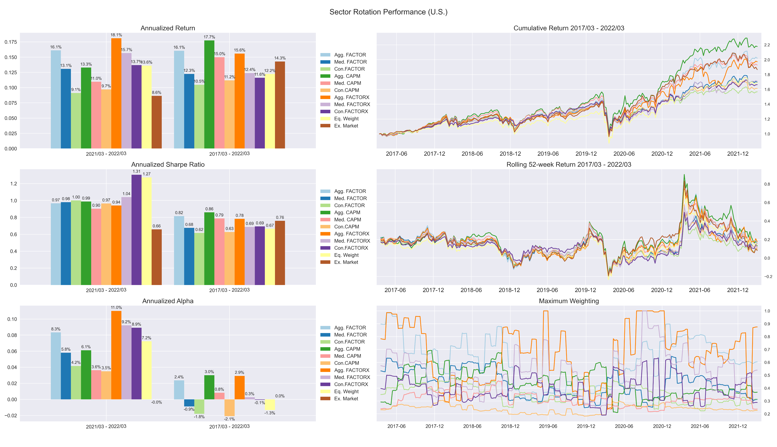
U.S. Portfolio - All (5-year window)

Slide 18
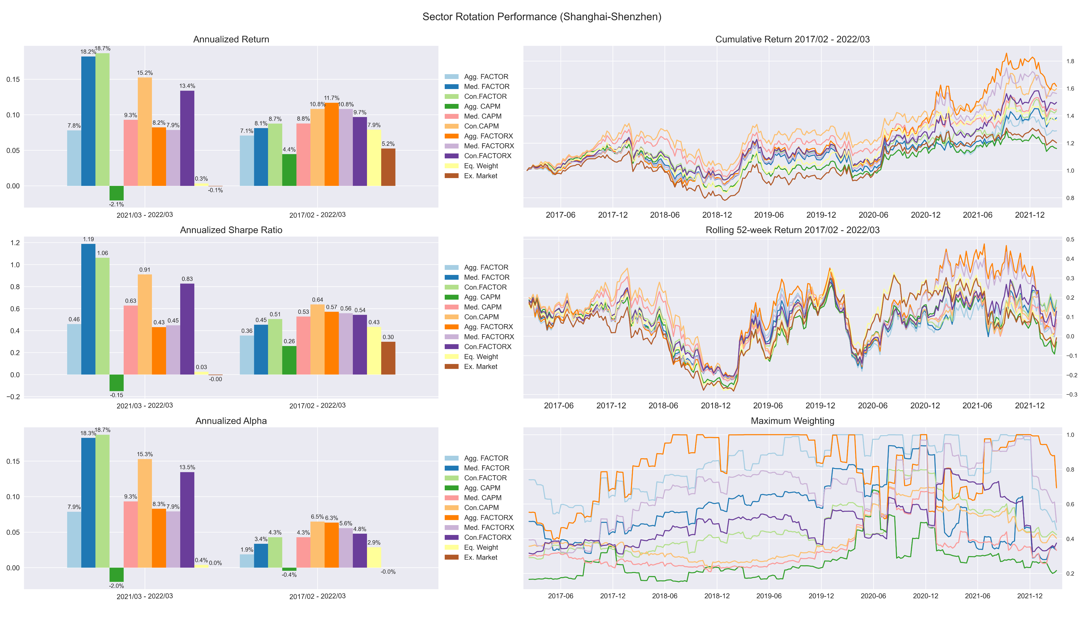
Shanghai-Shenzhen Portfolio - All (5-year window)

Slide 19
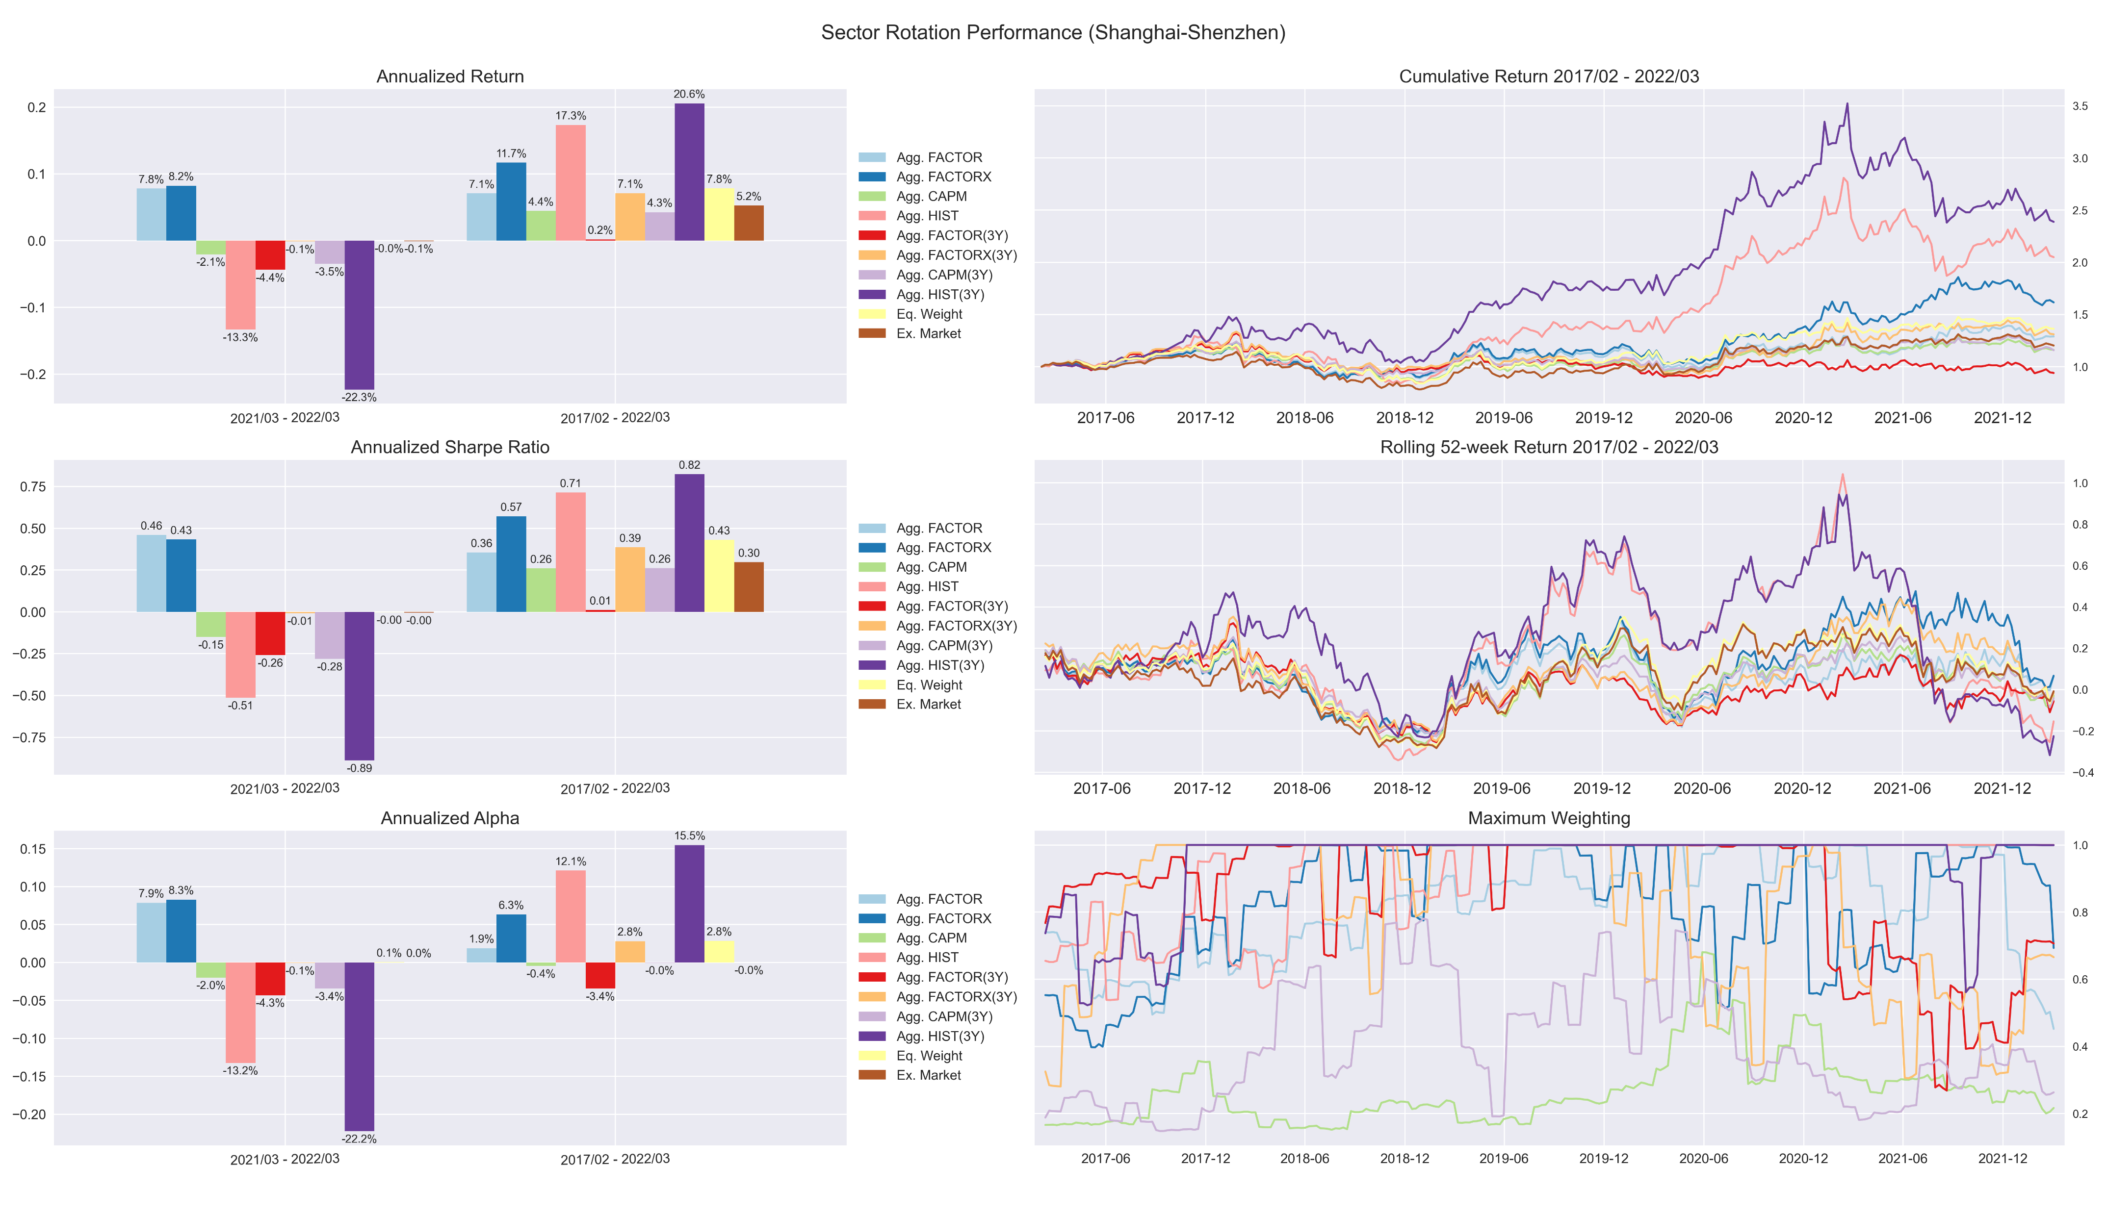
Shanghai-Shenzhen Portfolio – Aggressive (Total Return Index)

Slide 20
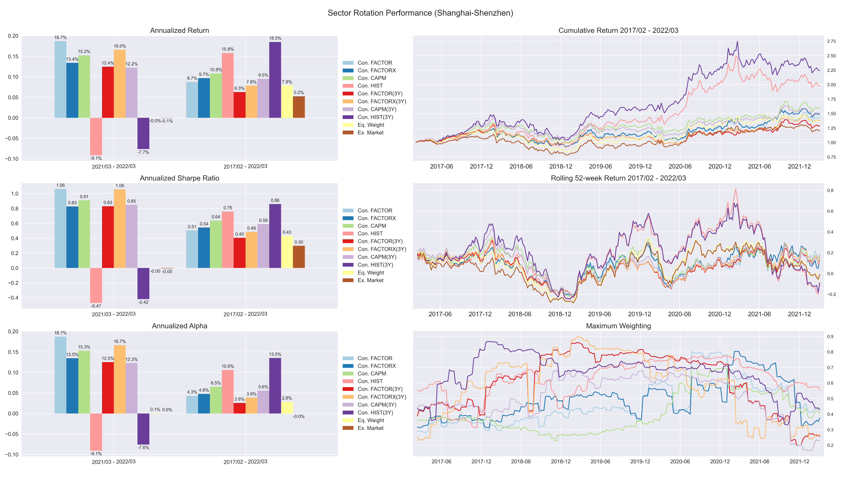
Shanghai-Shenzhen Portfolio – Conservative (Total Return Index)

Slide 21
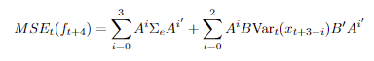
Conditional Covariance Estimation

Slide 22
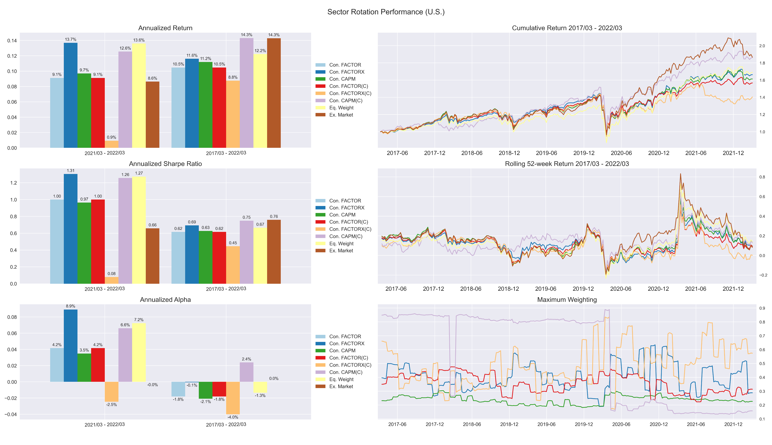
U.S. Portfolio – Conservative (Unconditional v.s. conditional)

Slide 23
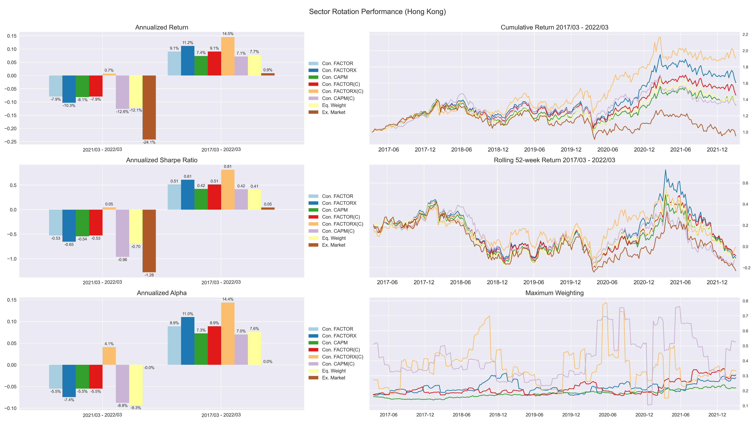
Hong Kong Portfolio – Conservative (Unconditional v.s. conditional)

Slide 24
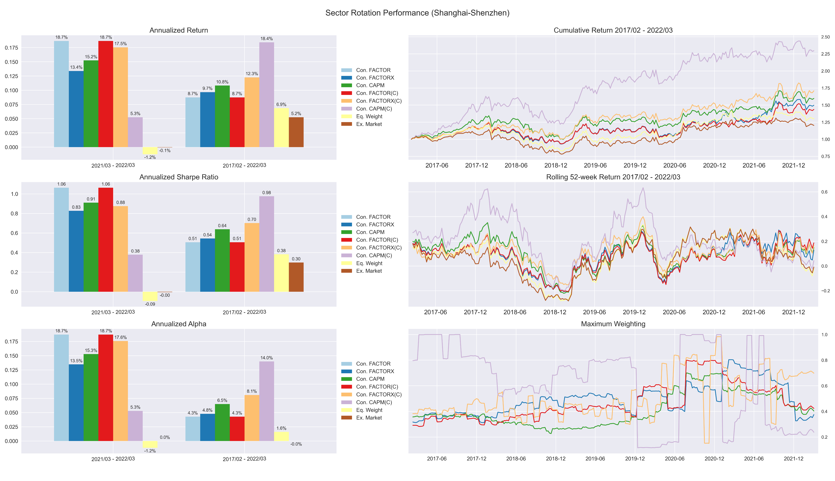
Shanghai-Shenzhen Portfolio – Conservative (Unconditional v.s. conditional)

